Slide 1
Its about to start...

Slide 2
Y
Shall we play a game? (Y/N)
_
_

Slide 3

Please insert coin.

Slide 4

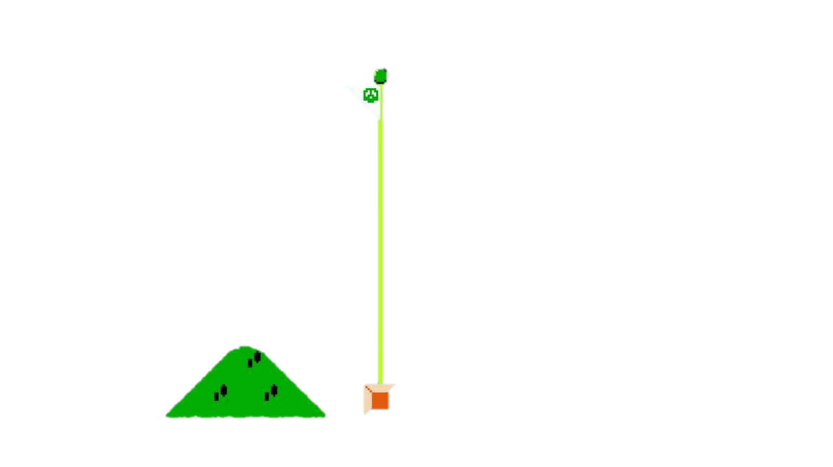



Slide 5

MARIO
003400
WORLD
Homechoice
TIME
Party

Slide 6



MARIO
003400
WORLD
Homechoice
TIME
Party

Slide 7



MARIO
003400
WORLD
Homechoice
TIME
Party

Slide 8
WELCOME
TO

Slide 9
Homechoice

Slide 10
COMMS
SESSION

Slide 11
SEPTEMBER 2020

Slide 12

ICT COMMS
SEP 2020

Slide 13


1
0
0

Slide 14




Slide 15








MARIO
003400
WORLD
Homechoice
TIME
Party
WYNBERG Showroom

Slide 16

ICT COMMS
SEP 2020
HOST:
BROWN MARIO
CO-HOST:
REVEREND LOVES
Notes:
Laveshan AnnaMalai
Atish Bhana

Slide 17
AGENDA
NEWBIES
BIRTHDAYS
PROJECT UPDATES
TECH REAL NEWS
MANAGERS UPDATE
We welcome some new members to the Homechoice family.
Many happy returns to our birthday boys and girls.. ☺
The ups and downs, the successes and the achievements.
The latest and greatest of technology in the news.
Lets take a step back and look at the bigger picture.

Slide 18


01
NEWBS
Notes:
Jeandre v Wyk
EMMY

Slide 19




QUIZ TIME
Notes:
Each of the four ghosts in the game has both Japanese and English names.
In Japan they started as Fickle, Chaser, Ambusher and Stupid.
Their English names are Inky, Blinky, Pinky and Clyde.

Slide 20


02
BIRTHDAYS

Slide 21


HAPPY BIRTHDAY !
SEPTEMBER
Xxx
Xxx
Xx
Xxx
Xxx
Xxx
xxx
OCTOBER
Xxx
Xxx
Xx
Xx

Slide 22
03
PROJECT UPDATES

Slide 23

Credit
XXX
XXX
XXX
XXX
XXX
Xxx
Xxx
Xx
Xx
xxx
Go-live +/- 2 weeks
xxx
xxxx
xxx
XXX
Starting next week
XXX
Notes:
FERZANAH

Slide 24
QUIZ TIME

Slide 25
xxxx
Time-based xxx
xxx Assort. + xxx Planning
PIM
PCM
xxx
(xxxxx)
Add new xx xx
- UAT
- Go-Live
In Progress
- xx xx xxx
- E.g. xx xx xx
xxx
xxx
XXXX (BACKLOG)
New Xxxxxx
- CXX
- Managing
User xxxx
Go-Live xxx
Notes:
TREVOR next..

Slide 26




DBA TEAM
POWER BI REPORT SERVER
HOMECHOICE CALL CENTRE
Upgraded to latest version..
Enhanced features, bug fixes…
IVR Option 4 change implemented successfully
WFS
OMEGA
RIEFAAT
JASON
1
2
Notes:
Riefaat

Slide 27

XXXX
DEPLOYMENTS
UPCOMING CHANGES
Xxxxxxxxxxxxxxxx
Xxxxxxxxxxxxxxxxx
xxxxxx
Xxxxx
xxxxx
Notes:
Reinhard…

Slide 28
QUIZ TIME
Notes:
LAVESHAN..

Slide 29
xxxxxx
Upcoming xxx
TRACK & TRACE
CHOICE XXXX
- Promenade (xxx) - xxx
Integrations:
xxxx
Custom friendly events:
xxxxx
Peak period
xxxx
Introductory session
Scoping session underway.
Notes:
SIRRAAJ…

Slide 30

xxxx
XXX
XXX - Complete
XXX – in progress
XX – in progress
XXXXXXXX – in progress
XXXXXX – in progress
XXX
XXXXXX – Complete
XXXXXX – in progress
XXXXX – in progress
XXX
XXXXX – Complete
XXXXe – in progress
RXXXX – in progress
Notes:
FAREEZ…

Slide 31


xxxxx
SUCCESS!
Coming Soon
SCORE: 51 of 202
Sound: ON
Upgraded:
- XXX
- XXXXXX
- XXXX
xXX
XXX
XXX
XXX
XXX
XXXXX
XXXXXXXX
XXXXXX
Notes:
ALBERT to say a few words…

Slide 32
QUIZ TIME

Slide 33
04
Tech REAL News
TECHNOLOGY…

Slide 34
TECH REAL NEWS
Notes:
Can anyone guess the latest news to do with technology?
And…. The theme of this presentation????

Slide 35



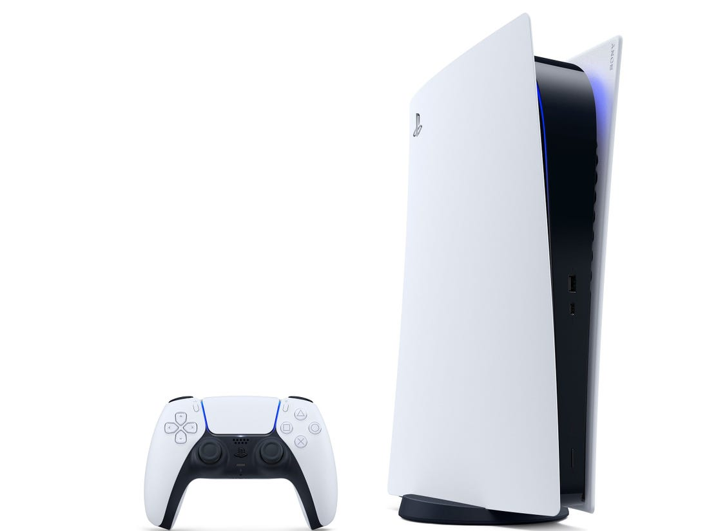
TECH NEWS
Notes:
https://strawpoll.com/1d4vk8ups
PlayStation 5 Specs: – CPU: 8x Zen 2 Cores at 3.5GHz (variable frequency) – GPU: 10.28 TFLOPs, 36 CUs at 2.23GHz (variable frequency), Custom RDNA 2 – Memory: 16GB GDDR6 – Internal Storage: 825GB custom SSD – Expandable Storage: NVMe SSD Slot – External Storage Support: USB HDD Support – Optical Drive: 4K UHD Blue-ray – IO Throughput: 5.5GB/s (Raw), Typical 8-9GB/s (Compressed)
Xbox Series X Specs: – CPU: 8x Zen 2 Cores at 3.8GHz (3.6GHz with SMT) – GPU: 12.155 TFLOPs, 52 CUs at 1.825GHz, Custom RDNA 2 – Memory: 16GB GDDR6 – Internal Storage: 1TB custom NVMe SSD – Expandable Storage: 1TB Expansion Card – External Storage Support: USB 3.2 HDD Support – Optical Drive: 4K UHD Blu-ray – IO Throughput: 2.4GB/s (Raw), 4.8GB/s (Compressed)
The console costs R9,999 for the Digital Edition and R11,999 for the standard model.
The Series X will be out on 10 November worldwide for US$499.99 — it will cost R11 999 in South Africa.
I think Homechoice has the Win a million promotion on right now… Can employees enter??
I NEED TO afford to buy these…
Speaking of affording.. I heard a rumour about a conversation in the office.
Apparently, Management was asking for suggestions about how to lure people back to the office..
I think the conversation went something like this…

Slide 36

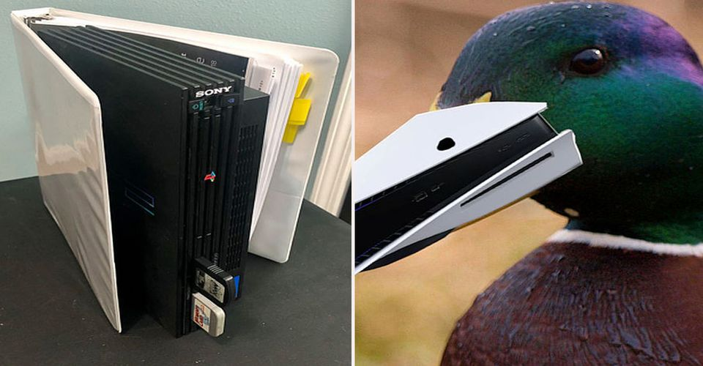
Can we have PS 5 ?
No, We already have PS 5 at Home choice…
AT HOME CHOICE…
Notes:
OFCOURSe, that went down VERY Well..
So, People asked if they get the NEW XBOX Instead…

Slide 37


Slide 38
05
Manager’s Update
Notes:
LOUIS

Slide 39
05
Manager’s Update
Notes:
LOUIS

Slide 40














PROMOTIONS!

Slide 41



